Slide 1
2021-2022 Program Overview

Slide 2
objectives
Provide an overview of Lexington Medical Center and its Nurse Practitioner Fellowship program
Review the application process for the 2021-2022 program year
Provide contact information for individuals directly affiliated with the fellowship program

Slide 3
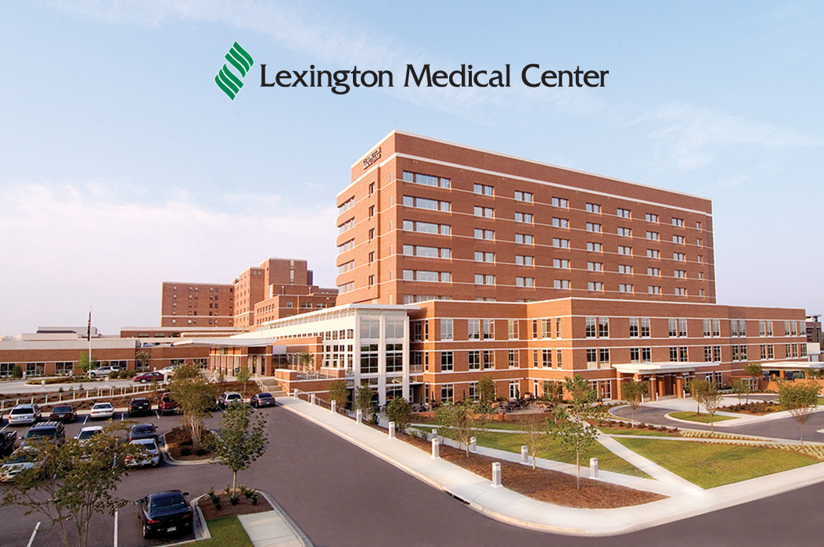
lmc organizational structure
Lexington Medical Center
Community Medical Centers
Acute Care Hospital
Physician Network
Extended Care and Skilled Nursing
Foundation/ Community Outreach
Occupational Medicine

Slide 4
mission, vision, and values
Our Mission
To provide quality health services that meets the needs of our community.
Our Vision
A coordinated health care delivery system that is accessible and affordable and that continually improves the health status of our community.
Our Values
Quality
Compassion
Responsibility
Integrity
Working with others to serve a common goal

Slide 5
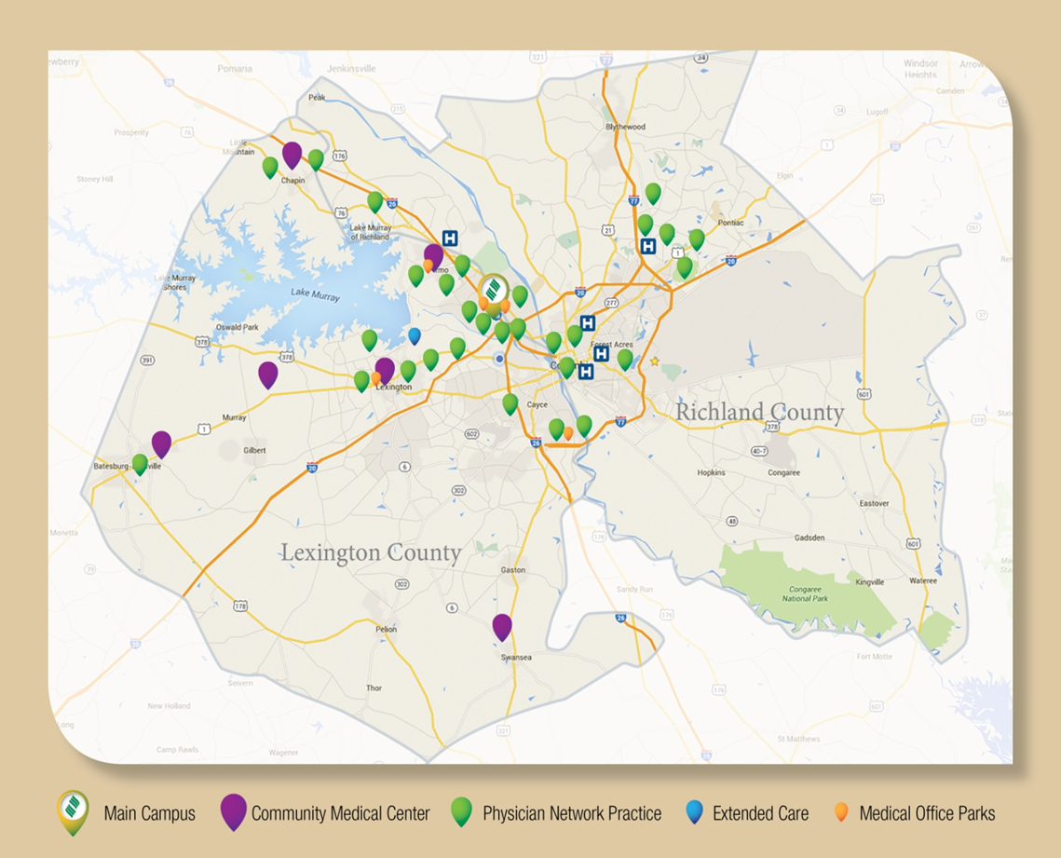
facility locations
Main campus centrally located in Midlands market and close to three major interstates
Physician Network
53 practices and 74 locations within Lexington and Richland Counties
Medical Parks
LMP 1, LMP 2, LMP 3, Otarre Pointe, Lexington and Irmo
Community Medical Centers
7 sites strategically located throughout Lexington County
LMC Extended Care
Largest nursing home in the Carolinas
Notes:
*Update

Slide 6
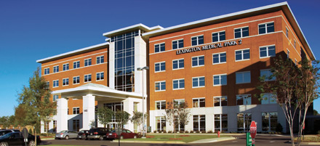
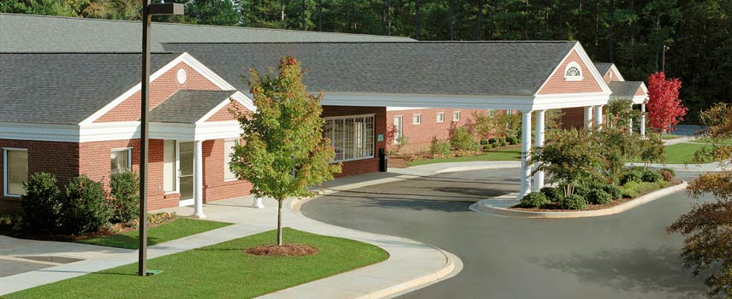
physician network
405 Physicians, 152 Advanced Practice Providers in 74 Locations
74 | Family Practice | 14 | General Surgery | 16 | Cardiology | 31 | Hospitalists
31 | Internal Medicine | 5 | Neurosurgery | 8 | Pulmonology | 8 | Critical Care
7 | Pediatrics | 8 | Cardiovascular Surgery | 7 | Oncology | 35 | Emergency Medicine
26 | Urgent Care | 1 | Plastic Surgery | 4 | Neurology | 18 | Anesthesiology
41 | OB/GYN | 13 | Orthopaedics | 4 | Rheumatology | 17 | Radiology
4 | Endocrinology | 3 | Podiatry | 3 | Infectious Disease | 2 | Radiation Oncology
6 | ENT | 4 | Psychiatry | 1 | Physiatry | 6 | Urology
3 | Occupational Health | 3 | Pain Management | 1 | Maternal-Fetal Medicine | 1 | Urogynecology
Notes:
*Update

Slide 7
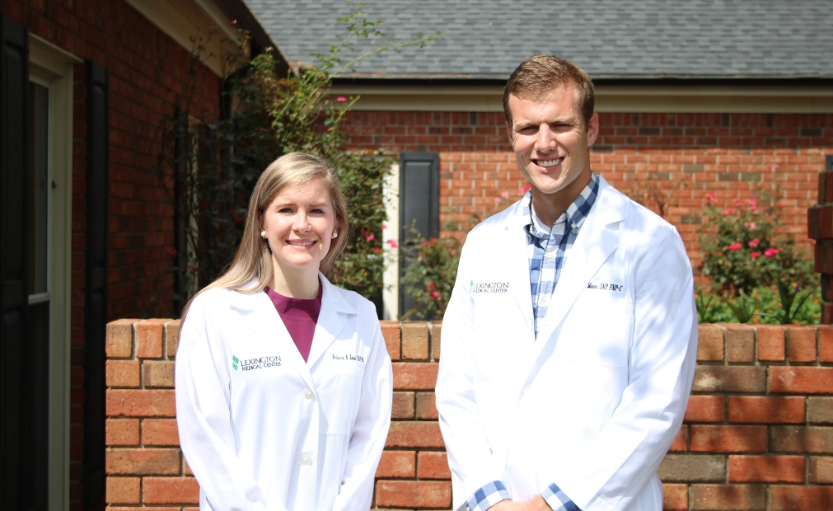
Program Objectives:
Meet the demand for access to high quality healthcare with well-trained, confident Nurse Practitioners
Provide quality health services that meet the needs of our community
Increase the clinical skills, confidence, productivity, and job satisfaction of new nurse practitioners, as well as contribute to employer satisfaction and workforce retention
Retain family Nurse Practitioners, who are committed to developing careers within Lexington Medical Center Physician Practices

Slide 8
nurse practitioner fellowship program overview
Created in 2016
Structured, one-year program
Fellows are full-time, salaried employees
Designed to augment new nurse practitioners with the depth, breadth, volume, and intensity of clinical training necessary to meet the clinical complexity of the practice of medicine
Fellows function in both the role of a provider and in a learning role receiving advanced training through practical hands-on and didactic educational experiences
Program structure includes primary care placement, specialty rotations, and didactic educational opportunities
Lexington Medical Center Physicians and Nurse Practitioners serve as supervising mentors to the fellow
Notes:
Recruiting for the 4th year of the program

Slide 9
continuity of care clinic
Fellows rotate within LMC Physician Network primary care practices. These placements are the foundation of the fellowship.
The fellows work closely with their preceptors to assess the appropriate number of patients seen per day and will gradually increase their caseload throughout the year.
Example caseloads by program weeks:
Weeks 01 – 02: Observe Physician
Weeks 02 – 20: 10 patients per day
Weeks 20 – 36: 12 patients per day
Weeks 36 – 52: 15 patients per day

Slide 10
rotation expectations
Under the supervision of a Physician, fellows will develop their own patient panel;
Assess the physical and psychosocial status of patients by means of interview, health history, physical examination, and diagnostic tests
Interpret data, develop and implement a plan of treatment, follow through on a continuum of patient care across the health-illness continuum and lifespan within standard protocols set forth and approved by both the nurse practitioner and practice physicians

Slide 11
expectations – specialty rotations
Fellows will spend one day per week rotating through specialties. Specialty rotations change monthly and are based on core specialties and each fellow’s interests.
Examples:
Cardiology
Pulmonology
Endocrinology
Radiology
Rheumatology
Orthopaedics
Neurology
Gynecology
Urgent Care
Rural Health
Occupational Health
Pediatrics
Gastroenterology
Infectious Disease

Slide 12
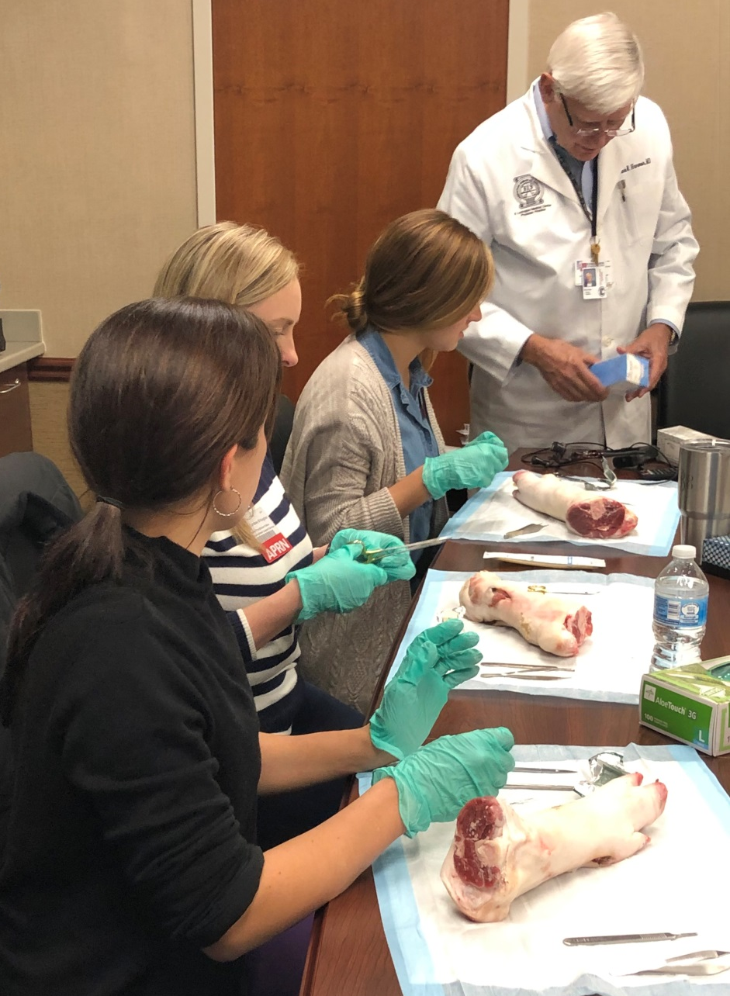
didactic education sessions
Two hours per week are dedicated to formal learning sessions and problem solving on a variety of clinical challenges. The content is delivered by a variety of guest speakers including physicians, nurse practitioners, former fellows, and the program medical director.
Examine case studies
Journal articles
Discussion of recent patient encounters
Hands-on learning

Slide 13
program timeline
Now accepting applications
All required application documents including the video interview are due by March 1, 2021
On-site panel interviews conducted in March 2021
Program start date in August 2021
Program end date August 2022

Slide 14
qualifications
Recent completion of a master or doctoral degree in nursing from an accredited college or university
Students currently in school must graduate by May 2021
Licensure in South Carolina as an advanced practice registered nurse obtained by August 2021
At least two years full-time nursing practice or equivalent experience in providing direct patient care within the previous five years

Slide 15
application process
1. Apply online at https://www.lexmed.com/careers/advanced-training/aprn-fellowship-program.
2. Complete the video interview process: Candidates will receive an email link to complete an online video interview, which must be completed within 48 hours. You will have up to 4 minutes to answer each question.
3. Submit a complete application packet by emailing a single document containing all required packet components to npfellowship@lexhealth.org.
Required application packet components:
Completed application checklist
Curriculum vitae
Transcripts of all completed and in process course work (unoffical accepted)
Three (3) letters of recommendation
Personal statement addressing the following questions:
What personal, professional, educational, and clinical experiences have led you to choose nursing as a profession and the role of a nurse practitioner?
Why have you chosen to apply for a Fellowship?
What are your expectations for a Fellowship?

Slide 16
application process continued
4. Select candidates will be scheduled for an on-site interview in March.
5. Candidates chosen for the 2021-2022 fellowship will be notified by April 2021.
Please email application questions to npfellowship@lexhealth.org.

Slide 17
program contacts
Shay Spires- Coordinator of Physician Network Development (Fellowship Program Coordinator)
(803) 939-4502
smspires@lexhealth.org
Kate Zannella, Ed.S., Director of Physician Network Operational Support, Education, and Development
kazannella@lexhealth.org
Patricia Perez- Human Resources Workforce Development Coordinator
(803) 936-4104
psperez@lexhealth.org

