Slide 1
Preventing Hospital Acquired Infections with CHG Treatment Baths
2022

Slide 2
Objectives
Discuss benefits of CHG ‘Treatment Bath’ for hospitalized patients
Describe a CHG ‘Treatment Bath’
Explain how to dispose of CHG cloths
Discuss how lines, drains and tubes should be cleaned with CHG cloths
Review Incontinence Care
Identify ways to encourage and educate patients on ‘Treatment Bath’
Identify alternative bathing methods for patients that are allergic to CHG or self bathe
Describes TIPS for successful CHG ‘Treatment Bath’
Notes:
This is the question that your experiment answers

Slide 3
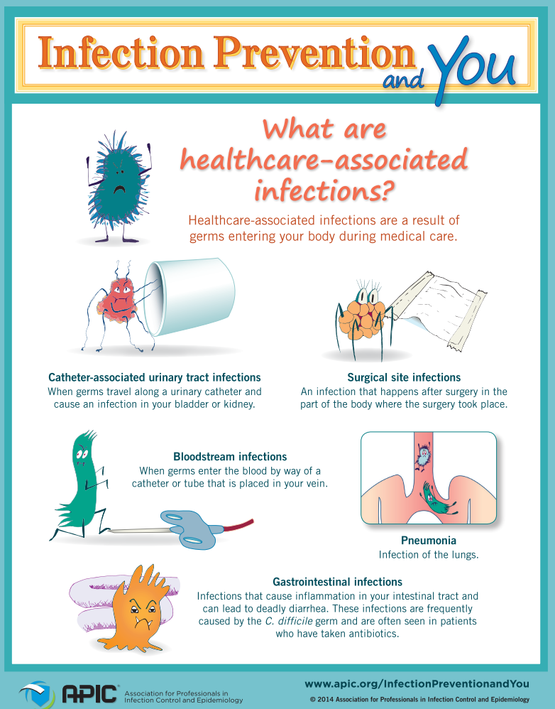

Evidence Review
About 1 in 31 hospital patients has at least 1 Healthcare Associated Infection (HAI) [CDC.gov]
Adequate Hand Hygiene is essential in the prevention of HAIs [CDC.gov]
Multiple evidence based articles note that Daily CHG Treatment Baths reduce HAIs [Frost, et al., 2106; Huang et al., 2016; Chapman et al.; 2021]
  CLABSI (Central Line Associated Blood Stream Infection)
  CAUTI (Catheter Associated Urinary Tract Infection)
  Surgical Site Infection
  C difficile gastroenteritis
  VAP (Ventilator Associated Pneumonia
Hospital Acquired Infections are PREVENTABLE!
Notes:
This is the question that your experiment answers

Slide 4
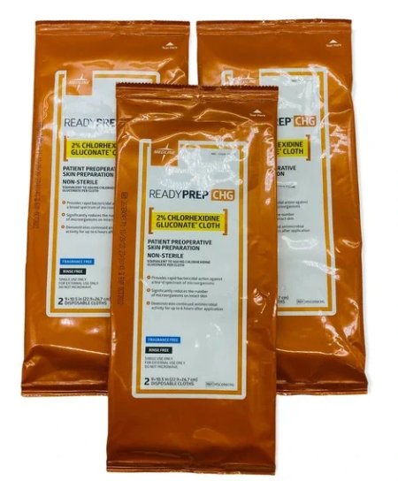
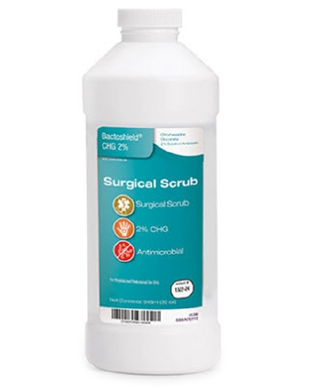
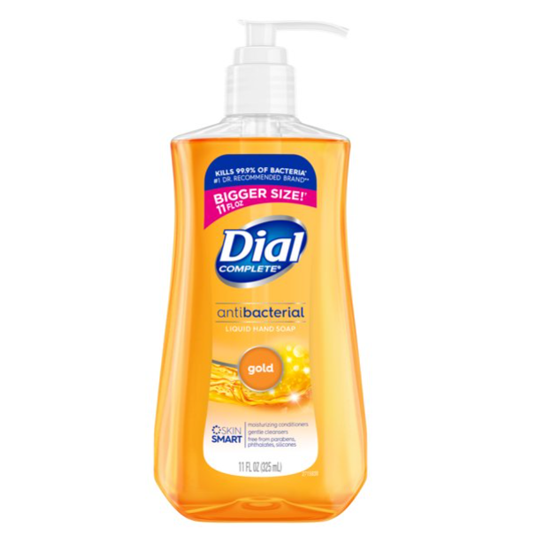
Products
CHG Wipes | CHG Solution | Dial Soap
Preferred Highest concentration of antiseptic left on skin Must be used on ALL patients with CENTRAL LINE or FOLEY CATHETER. If a patient showers, tubes/ lines should be cleaned with CHG wipe after the shower. | Not preferred Lower concentration of antiseptic left on skin Should be approved by Nurse Used for patients that can shower Do NOT use for patient with CENTRAL LINE or FOLEY CATHETER. If a patient showers, tube/line should be cleaned with CHG wipe after the shower. | Used in patients with allergy to CHG Document allergy to CHG in Epic

Slide 5
What is a CHG ‘Treatment Bath’?
Chlorhexidine gluconate (CHG) is an effective antiseptic that can fight many types of germs that cause infection
CHG cloths have a cumulative effect when used daily (works better)
We will refer to it as a CHG ‘Treatment Bath’ so that patient is aware that this is part of their treatment AND also their bath
Evidence supports daily CHG ‘Treatment Baths’ reduce the spread of infections in hospitals
  Kills almost all bacteria and viruses on the skin
  Safe to use on genital area
  Works for 24 hours after Treatment Bath

Slide 6



Educating and Encouraging Patients
Your enthusiasm and encouragement is critical in protecting patients from preventable Hospital Acquired Infections.
It is important that patients understand that this is an important part of their treatment.
Education is crucial in patients understanding the benefit of CHG ‘Treatment Bath’:
  Evidence supports that CHG ‘Treatment Bath’ reduces germs on your skin better than soap and water.
    It does not lather up like soap and water
    Massage into all areas (including skin folds); rather than wiping
    Safe to use on genital area. Evidence shows CHG can be used safely on inner labia and over urethral meatus.
    Do not use on Head/ Face
  CHG ‘Treatment Bath’ serves as a protective bath to prevent infections.
  CHG cloths contain a moisturizer that may feel sticky for a few minutes. This will go away after air drying. Allow to air dry before getting dressed.
  DO NOT FLUSH! Dispose in trash can.
If patient DECLINES CHG ‘Treatment Bath’ notify nurse and document in Epic
Allow to Air Dry

Slide 7
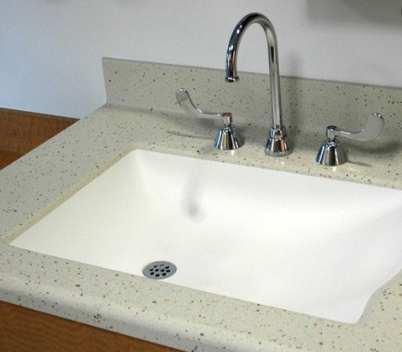
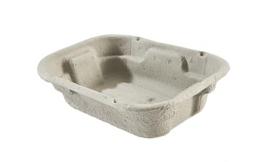
Who gets a CHG ‘Treatment Bath’?
ALL Inpatients everyday except vaginal deliveries on Mother/ Baby
  C/Section patients on Mother/Baby will receive CHG ‘Treatment Baths’
No ‘Sink Baths’ or ‘Basin Baths’
X
X
Notes:
Summarize your research in three to five points.

Slide 8
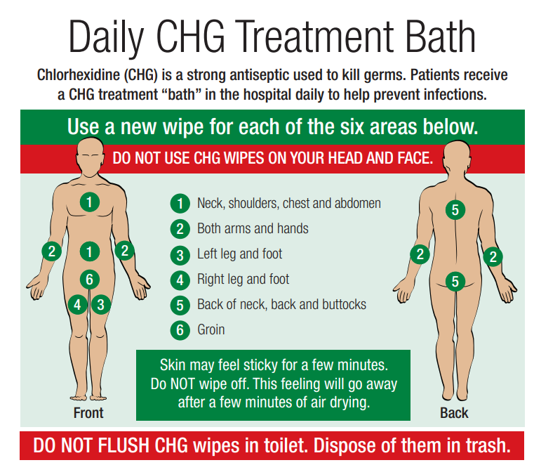
CHG ‘Treatment Bath’ Patient Education
Use firm pressure and massage into skin; rather than wiping
Do NOT Rinse
Allow to air dry
Avoid using lotions or soaps from home. May prevent CHG from working.
Do NOT use on open skin/ wounds

Slide 9
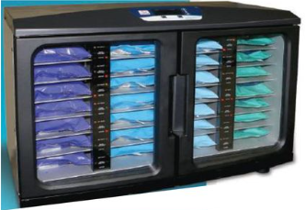
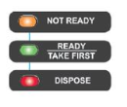
How to use CHG Cloths?
Warmed CHG Cloths can be found in the Clean Supply Room on each unit. Cloths can be used at room temperature but it is more comfortable for patient if warmed.
  It takes about 2 hours to warm in the warmer.
CHG Cloths must be used within 84 hours of warming.
Do not put cloths back in warmer after removed
Plan to use at least 6 cloths per ‘Treatment Bath’, but you can use more if needed.
Firmly massage skin. DO NOT RINSE OFF!
  Use on intact skin only
Do not use CHG Cloths above the neck.
  Do not use to clean the face.
Light Indicators
Orange Light
Cloth is warming, not ready
Solid Green Light
Cloth is ready to use
Flashing Green Light
Take First – getting close to aging out
Red Light
Expired, dispose
Notes:
Summarize your research in three to five points.

Slide 10

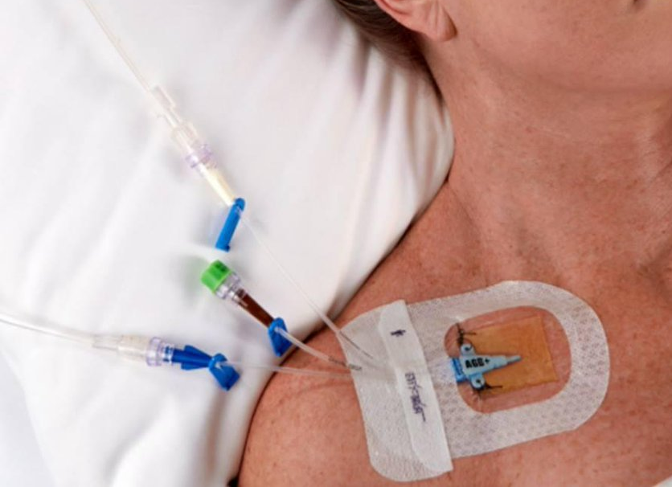
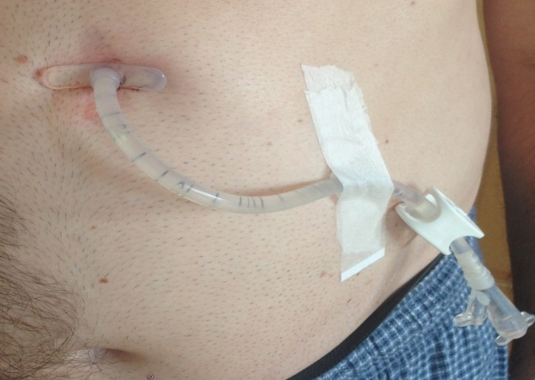
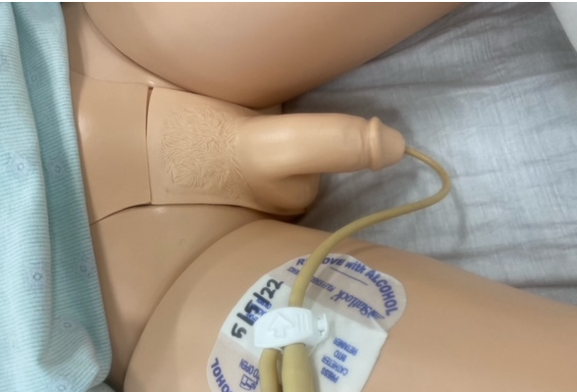
Lines, Drains, and Tubes
Wipe 6”
After bathing skin, clean the Central Venous Lines, tubes, and catheters 6 inches away from skin with a clean part of CHG wipe.
  Start closest to the skin
  Use a separate cloth for each line, drain, and tube
  Refer to LMC Chlorhexidine Gluconate (CHG) Treatment Bath Policy/ Procedure
Before cleansing Urinary Catheter, perform hand hygiene and apply new gloves!
Start closest to insertion site and work out 6 inches
ALL patients with a central venous line or Foley catheter should receive a CHG ‘Treatment Bath’ with the cloths (not liquid)
  If patient wishes to shower, you can use the cloths after the shower for the tube/line
Wipe 6”
Wipe 6”

Slide 11
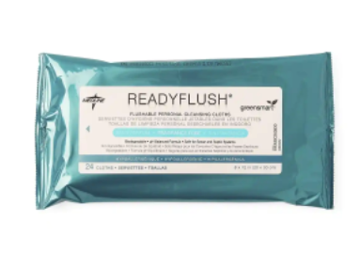
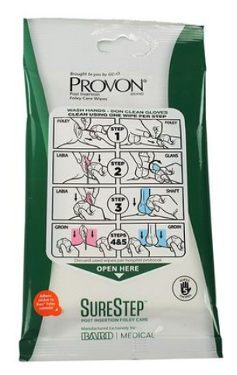
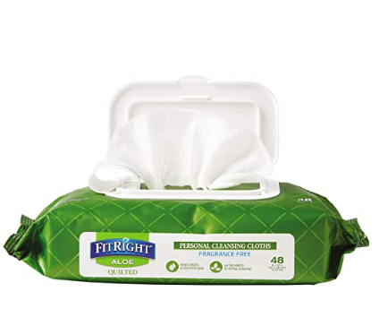
Incontinence Care
Incontinence Care WITHOUT Urinary Catheter | Daily Foley Care | Incontinence Care WITH Urinary Catheter
Non-CHG wipes are used for routine incontinence care (ex: ReadyFlush, FitRight Aloe) | Done daily during ‘Treatment Bath’ WITH CHG Cloth | Provon wipes will continue to be used for any Foley care needed after incontinence that is not at the time of CHG ‘Treatment Bath’

Slide 12

Responding to Patient Concerns
I don’t feel as clean after bathing with these cloths
I know people usually think of a bath with soap and water. To help get you better and prevent infections, these CHG cloths will clean your skin by removing germs.

Slide 13
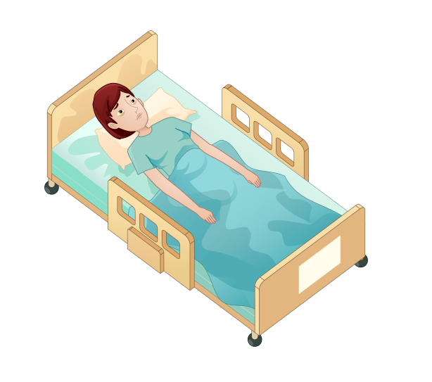
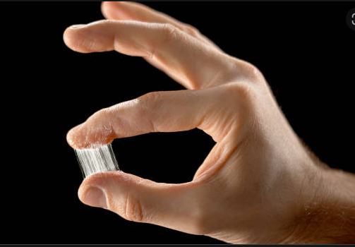
Responding to Patient Concerns
I don’t like these cloths. They leave my skin feeling sticky.
The sticky feeling is due to the aloe in the cloths which moisturizes your skin while it cleans. The sticky feeling goes away after a few minutes. Let’s try and you will see that after a few minutes your skin will feel soft and not sticky anymore. It will go away with air drying.
Allow to Air Dry

Slide 14
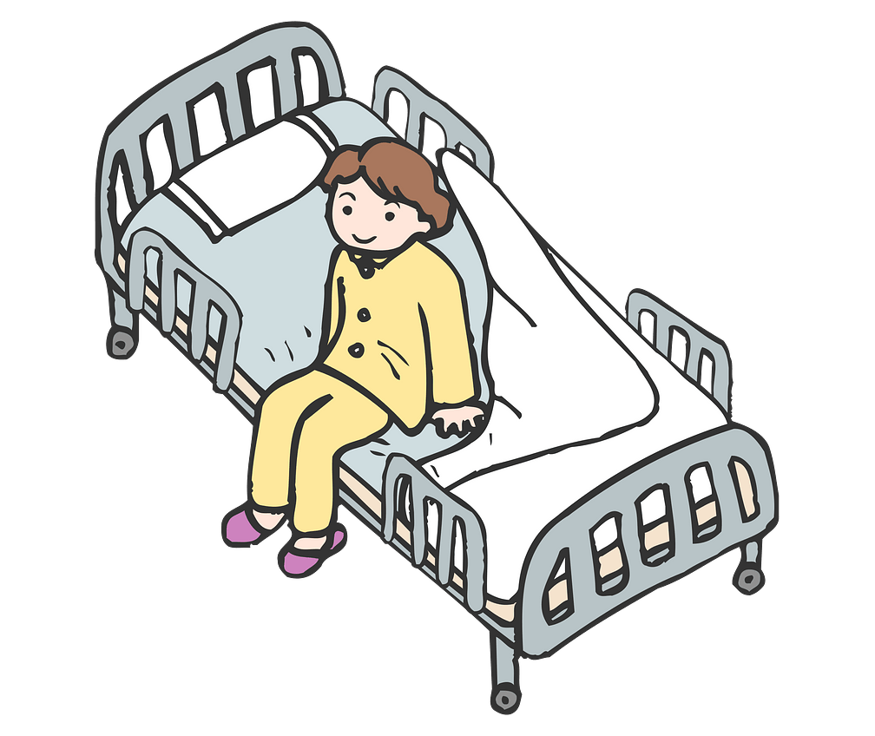
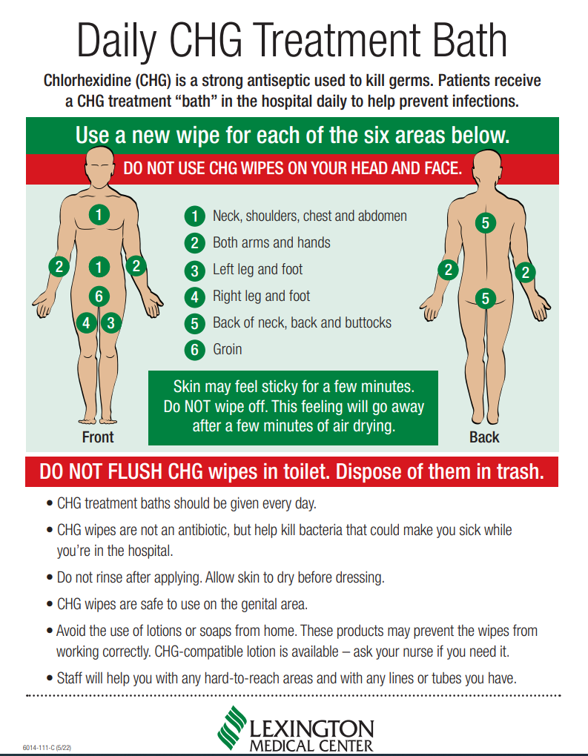
Responding to Patient Concerns
I would prefer to perform my own bath
Great! Let me review with you each step and you can stop me at anytime and ask questions. I can help with the hard to reach areas as well as clean on and around your lines and/ or drains.
.

Slide 15
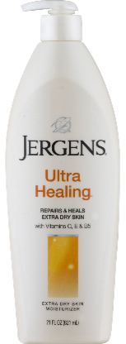
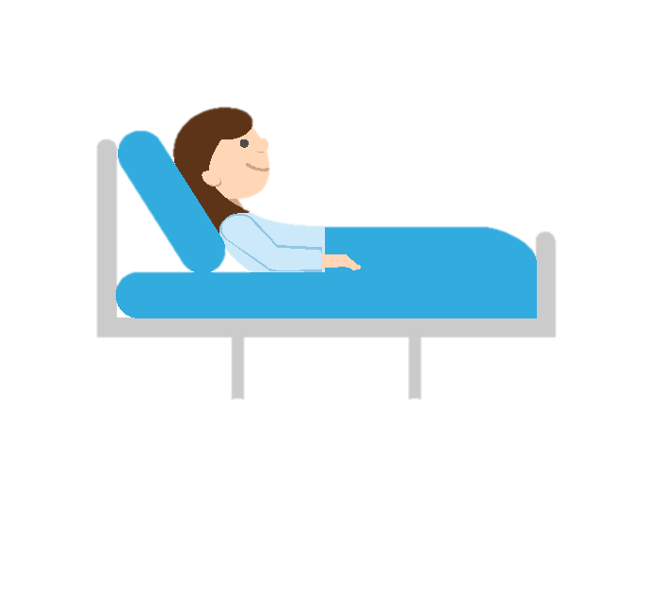

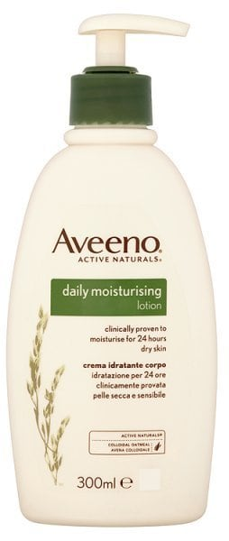

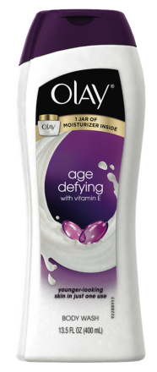

Responding to Patient Concerns
Can I use my own soap/ lotion along with this bath?
We want to make sure this CHG ‘Treatment Bath’ works. Let’s stay away from other soaps and lotions for now. Outside products may cause CHG to be less effective and reduce infection prevention benefits.

Slide 16

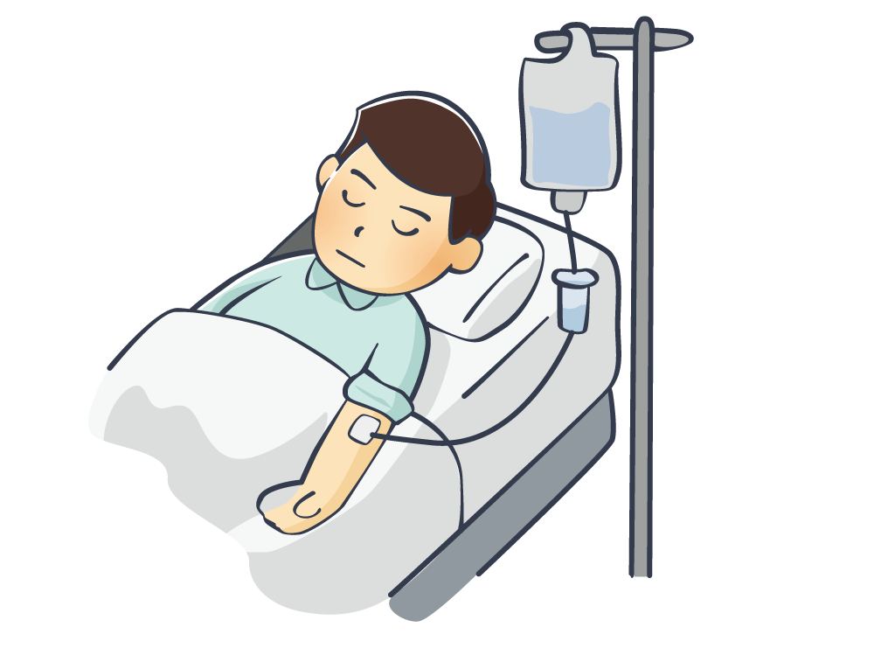

Responding to Patient Concerns
I am too tired and I don’t feel like bathing
I am sorry that you are not feeling well. I will come back in 1 hour to check on you and help you with this important CHG ‘Treatment Bath.’ It will only take 5-10 minutes and will make you feel refreshed.

Slide 17
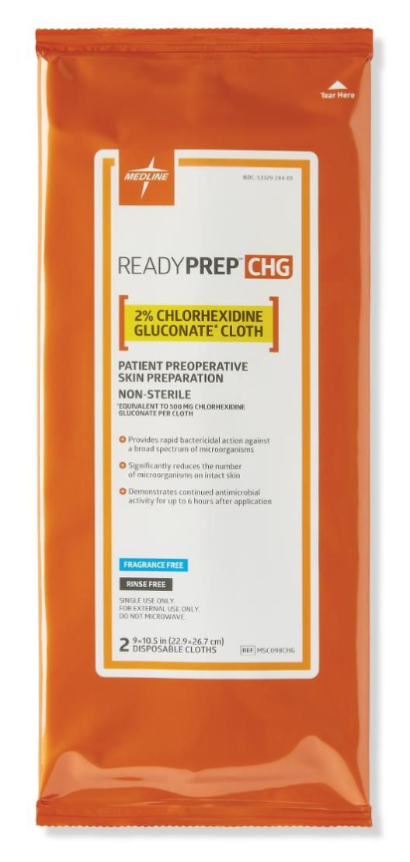
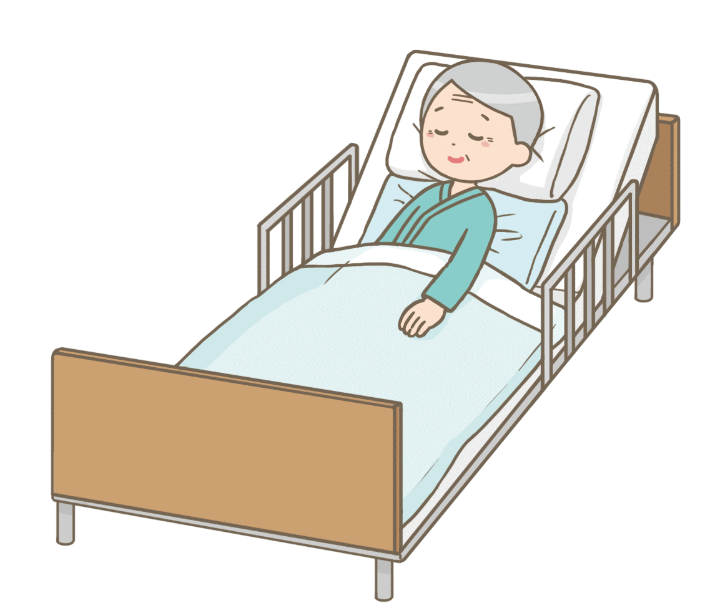

Responding to Patient Concerns
CHG cloths are labeled as pre-operative. Is it okay to use for routine bathing?
Yes, CHG is safe to use for daily bathing. We want to protect you while you are in the hospital and help you to feel better soon. Hospitals have been using this bath/treatment for some time before surgeries. It is safe for our patients.

Slide 18
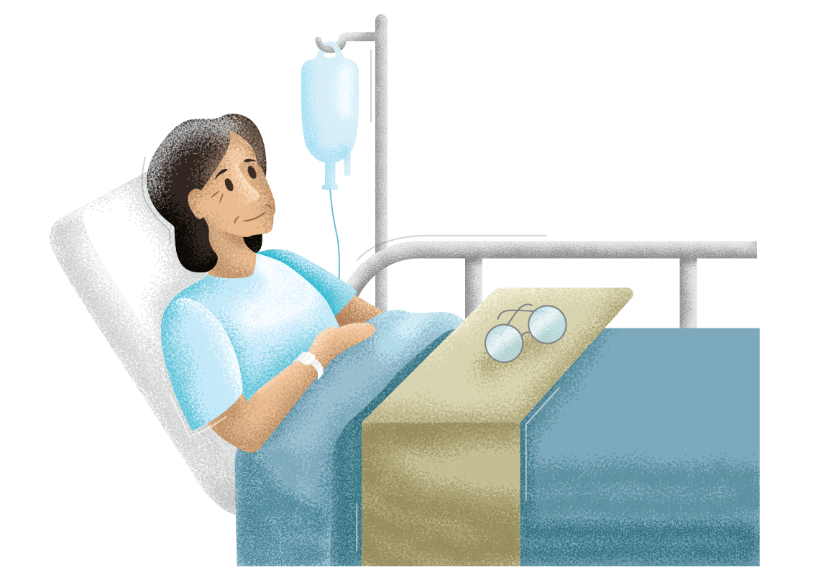
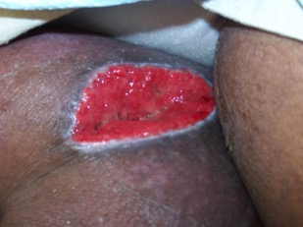
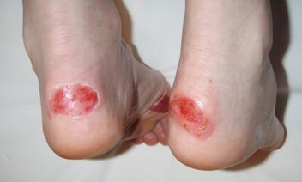

Responding to Patient Concerns
Can I use CHG on wounds?
No, we will not use the cloths on open skin or wounds.

Slide 19

Tips
Allow skin to air dry before you apply adhesive; if not completely dry adhesive may not stick well
  Electrodes may not adhere as well causing ‘noisy’ or inadequate signal
  Dressings may peel up
Do NOT save opened package for later use
Do NOT use on open skin/ wounds
Do NOT flush the cloths. Dispose of in trash can.
Do NOT use these cloths for routine incontinence care (outside of daily CHG ‘Treatment Bath’
You should use at least 6 wipes per bath, but can use more if needed
Do NOT share wipe packs between patients.
If patient DECLINES CHG ‘Treatment Bath’ – please let the primary nurse know

Slide 20
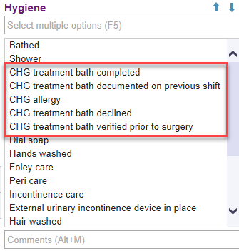
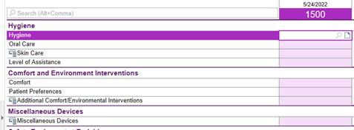
Epic Documentation of CHG ‘Treatment Bath’
Document Daily on the Daily Cares/ Safety Flowsheet
If patient DECLINES CHG ‘Treatment Bath’ – notify primary nurse

